Slide 1
Behaviour Policy
Harthill Primary School

Slide 2
Parent Presentation 09.01.24
These slides were delivered to parents who attended the presentation on 09.01.24.
The presentation was intended to respond to the key concerns identified through the parent questionnaire and not an extensive breakdown of the entire policy.
The key concerns were:
That it should be discussed more with parents (hence the opportunity to attend)
That there should be a policy which everyone is aware of (available on our website)
That there are no clear sanctions in place (information on slides)
That children are not “told off” in front of others (information on slides)
Concerns had also been expressed separately that some children appear to be repeatedly acting in in in appropriate ways and that “nothing is done” – our school response to this is also on the slides.
Responses to questions/concerns raised during the meeting are also on the slides.

Slide 3
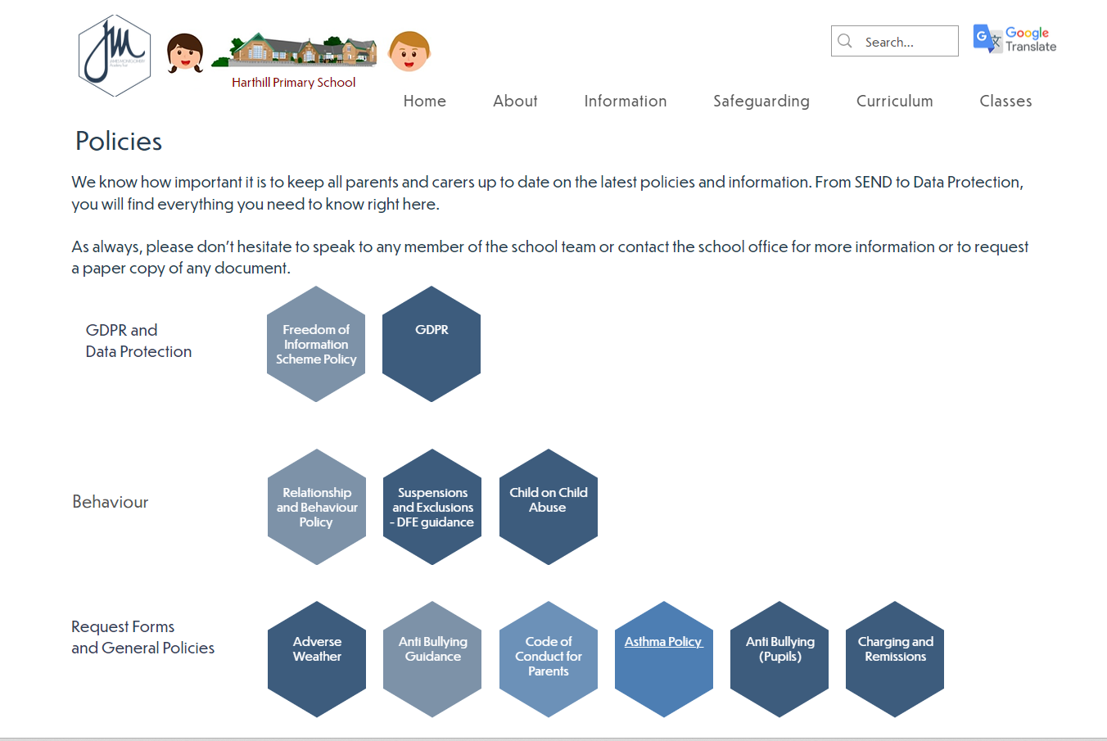
Behaviour Policy
Policy for relationships, regulation and restorative practice
Access via the website
https://www.harthillprimary.co.uk/policies
All behaviour is communication
whether positive or negative)
Policy is reviewed annually.
Notes:
Behaviour policy as it is traditionally called but this is a term which has fallen out of favour - gives connotations of the word behaviour equating to something negative whereas actually “behaviour” is how we all conduct ourselves, whether in a positive or negative way. Our mantra at the start of our journey to changing our policy was “All behaviour is communication” Our policy is actually one which outlines how we support pupils to form positive + healthy relationships, how to develop their regulation and how we use restorative practice as part of doing this. These terms will be discussed more later on. For ease, will refer to it as our behaviour policy as this is a term we are all familiar with.
Please have a look at the full policy at your leisure and we can always have another meeting – it would be impossible for me to cover the entirety of this policy in this meeting as many of the strategies for how to manage behaviour in a classroom are linked to teacher training; having an exhaustive list of all the ways we do this and talking you through them one by one would be a long task. Today – focus on the overall message of our policy linked to relationships, regulation, reflection and restorative practice including what our policy says and what this looks like in school.

Slide 4
School Values
School Value consultation in 2020 involved all stakeholders.
Drivers for our school ethos and all we do to support a positive culture.
Basis of our behaviour policy.
Notes:
Can parents name our values?

Slide 5
Research – our policy was based on a range of evidence
‘’When people talk about behaviour, they obsessively search for the instant solution. Some peddle magic dust or ‘behaviour systems’ that glisten yet quickly fade. Others relentlessly scream for a bigger stick to beat pupils down with. Both extremes harbour an irresistible idea that there is a short cut to changing behaviour. They sell the lie that you can provoke sustained behavioural change in others without doing much hard work yourself. The truth is that there is no alternative to the hard work: building relationships with those who would rather not, resetting expectations with those who trample them, being relentlessly positive and sustaining a poker face when confronted with challenging behaviour.’’
Paul Dix, Pivotal Education
(Behaviour specialist, author, education reformer and advisor.)
Notes:
This research (along with others) have been key to underpinning our policy design (both at MAT and school level). Our policy was already adapted in line with this before the academy moved theirs, meaning we were consulted on the wider policy and lots of ours was used as the template for other schools.
It is different, it isn’t the system that was in place when I was at school and a lot of these comments are familiar to school leaders – “What are you doing about behaviour” is not a quick fix and can often look like nothing is being done. This is not ever the case but in my experience reward charts, punitive sanctions such as red cards, detentions or isolation don’t change behaviour (they devastate the few who make a small mistake and have no impact on others who are lacking in the ability to self regulate.

Slide 6
“The modern school cannot work on the principle of suppression and punishment, but rather on the idea of trying to understand and solve children’s personal problems” (Adler, 1927).
The meaning of discipline is “to teach rather than punish. A disciple is a student not a receiver of behavioural consequences” (Siegel, 2012).
Notes:
Alfred Adler - Austrian medical doctor, psychotherapist, and founder of the school of individual psychology. He emphasised the importance of feelings of belonging, family constellation and birth order set him apart from others. He proposed that contributing to others (social interest) was how the individual feels a sense of worth and belonging in the family and society.
My point here is not that we’re guided by stuff that’s really old, more that these ideas have been proposed for nearly 100 years but schools are sometimes only beginning to enforce the learnings from them (in a positive way)!

Slide 7
One last thought from our parent governor...
When working with so any children, it is not always easy to get it right – just as we don’t always get it right as parents.
In the long term, a restorative approach to behaviour pays off and avoids being a “quick fix.”

Slide 8
Relationships
The way people are connected. In this context; the way they interact and behave towards each other.
How children connect with each other and with staff
Our policy:
“good behaviour stems from positive relationships and mutual respect between adults and children.”
“has effective strategies to establish good relationships and each staff member has a responsibility to ensure these strategies are upheld”
Notes:
For our policy this means between children as well as between children and adults.
Consider different relationships – age difference, gender, friends, unknown people.
Children need to feel secure enough with adults to learn from mistakes – this needs strong relationships.
Children need to believe in the adults they are around to follow their modelling about positive conduct.
Positive relationships ensure that children are motivated not to disappoint and to still feel valued if they do make mistake.
Positive regard is something we talk about a lot – we have positive regard and respect for our pupils even if we do not respect the behavioural choice they have made.

Slide 9
Regulation
Behaviour regulation, sometimes also known as “self-regulation”, refers to our ability to:
-use self-control to behave in appropriate ways – this may mean controlling our impulses so that we stop doing something or it may mean doing something, even if we don’t want to
-manage our energy, emotions, attention and behaviour in ways that are socially acceptable and help us to achieve our goals
-stay calm, focused, and alert
-deal with things that stress our system,
Our policy:
“We do not presume that children will instinctively know how to behave well and as such behaviour is taught through a well thought out structure linked to each schools’ behaviour expectations.”
Notes:
Stop doing something e.g. snapping at someone in a supermarket when we’ve had a long day or doing something we don’t want to do e.g. being polite at your boss when you think they’ve been unfair.
Stress to our systems - like too much noise, fatigue, challenging situations or tasks, or distractions
As well functioning adults, we have these skills and for the most part children can be taught these skills which then develop in an age appropriate way. This is part pf the basis of our policy and practice. For some children, specific need means it takes longer for them to learn these skills and this needs targeting (we know people who don’t have these skills because they weren’t taught and supported to develop them.)
“They should know better” – problematic as children knowing how to behave and being able to regulate so they can do it are two different things. This is not an excuse for poor behaviour, but it is a fact that we have to consider when we

Slide 10
High expectations – school rules
Pupil voice in November showed us that all our children can name our school rules (We are: Ready, Respectful and Safe) and can discuss what these mean in practice and what happens if they do not follow them.
These rules are embedded for the majority through:
Reference in assembly
Reference in class
Positive noticing (spotting, commenting and praising everywhere it’s going right and ensuring children know this.)
Respectful challenge in classrooms and wider school environment where it isn’t going right.
Reference in conversations with pupils where reminders are needed
Notes:
Majority – these are the children who know rules and have the ability to regulate appropriately (i.e. they do not have a need which prevents them from doing this.) Examples of behaviour we often need to challenge: running in corridors, shouting out, talking in assembly, low level disruption in class.

Slide 11
Teaching Regulation
Lower down school and pupils with specific need – in the moment supported reflection and support for pupils managing selves and each other.
Impact of COVID meant that children who missed KS1 missed a lot of early in the moment intervention as their brains were developing. School have had to catch up on this for children whose bodies and brains developed at a different rate to their social experiences due to school closures.
Bespoke intervention for individuals is designed with their specific needs considered.
Notes:
EYFS – sharing, good learning behaviours, listening to each other, taking turns. KS1 – managing relationships with each other and developing empathy and understanding of different view points.
KS2 – Worth noting that covid had an enormous impact on the children currently in KS2 who missed this in KS1. Their brains and bodies developed at a different rate to their relationship experiences so we have employed a lot of the same strategies higher up school that we do lower down in a way that schools don’t usually necessarily need to do on the same scale.
Intervention – specific programme of support for individuals who have identified social, emotional or mental health needs (including those around communication and interaction) which needs something more personalised.

Slide 12
Responsive approach
Reflection is key
-what has happened
-why it happened
-what impact did it have
-how we stop it from happening again
Private conversations occur – we do not shame individuals despite choices
Comic strip conversations
https://calmandconnected.com.au/comic-strip-conversations/
Visual resources (post incident learning pack)
Notes:
Responsive – responding to something that has happened (consistently disruptive, a violent action, swearing, refusal, rudeness). Reflection – supporting children to give consideration for their actions to help them to identify what they did and why, to consider the impact of these actions on others and to work on how we prevent it from happening again.
Private conversations – can be controversial and something we are looking at in response to parent voice. Children who have been “wronged” by another child’s actions don’t necessarily know that it has been dealt with. Currently adults have the restorative conversation in private with the child who has not made good choices. More on this later.
Talking not always the most effective way to support – children who are stressed aren’t able to take in what we are saying. Always wait until they are calm so might not have a conversation straight away (in nobody’s best interest). Comic strips – write these as going. Help children to identify what happened and helps us to put forward what we think might have happened. Supports to get both sides of a story and to be very precise.
Post incident learning pack: What happened, how did you feel, why did you feel that way, who did it involve, how do they now feel, what could we do differently next time.

Slide 13
Personalised longer term approach
Pupils with identified difficulties – this can be for lots of different reasons.
Longer term strategies:
Social stories
Emotional literacy
Self esteem work
Hidden Chimp
Visual timetables/now&next and other strategies to support in class
Safe space
5 point scale
Notes:
Identified difficulties – identified SEND, trauma, adverse childhood experiences, temporary difficulties at home, mental health difficulties, grief/bereavement, low attendance, being in the care system.
These are the pupils who we get the most feedback about as it is perceived as “always” towards “everyone” and “with no consequences”. In every school there will always be those names. We do not tolerate the poor behaviour of these pupils but we also go back to earlier in this presentation – there is no magic wand to wave which will help these pupils suddenly know how to behave appropriately and there are no longer specialist schools with lots of spaces which pupils are sent to and there is a national school funding crisis which means specialist support and additional staffing is difficult to put in place. . Our job as mainstream schools is to support these pupils to learn to regulate over time, put risk assessments in place to minimise the impact on others and to work with families to reduce the incidents and help children move from co-regulation where they need lots of help to self-regulation where they can do it for themselves.
If a child does not know how to regulate or due to current circumstances cannot access the part of the brain needed to help them regulate, we cannot blindly punish them into doing so through detention, isolation and non purposeful removal of privlidge.

Slide 14
Consequences
Ready, Respectful and Safe
Balanced and measured consequence to an action
Purposeful removal of privileges
-restorative conversations in their own time
-putting right what has gone wrong
-time out of an activity (football, dinner hall, after school club) with time spent teaching how to put it right
Conversation with a senior member of staff to emphasise the seriousness
Parents informed – calls, emails, requests for meetings
Internal Exclusions – incorporating restorative practice
Fixed Term Exclusions – reintegration meetings
Notes:
We support those with difficulties but this does not make them exempt from a consequences.
Previously spoke of a “non purposeful removal of privileges” – by this I mean a consequence which does not link to the original behaviour. E.g. red card system previously in place – same consequence for deliberately kicking someone during football, continuing to play when whistle has gone, talking in guided reading and making a racist comment. These are all very different actions which need responding to in different ways – a blanket isolation or detention approach is not going to get anyone to reflect on their actions or change future behaviours (other than potentially inspiring some to not get caught again). To give all the same would not be balanced.
Purposeful – mostly that the restorative conversations we have with children happen in their own time and rarely learning time (does depend on seriousness.) Putting something right that has gone wrong e.g. repainting a wall, tidying something up that has been thrown, picking up litter, apologising, completing work that was missed – again in their own time. Time out of a certain activity until an improved behaviour in that context can be seen. SLT – most common that staff in classrooms manage behaviour; they are with these children ina learning environment more than I am so it is them the children need to respond to. However, some situations do require my intervention. Conversation with parents. Suspension (not necessarily the most impact for a child who would rather be at home but does offer a reset situation) – must be followed by a reintegration meeting to plan for change. Suspension my discretion; based on knowledge of child.

Slide 15
Positive engagement
Extrinsic rewards to reinforce our daily recognition:
-Values cubes
-Star of the week + Hot Choc/Freezer Friday
-Star of the term
-Texts home
-Emails/calls home
-Go and Show a member of staff to celebrate and praise (usually Mrs Littlewood)
Pupil feedback tells us these systems are valued and act as a motivator for most.
Notes:
Cubes link to values and then to a whole school reward; all children included no matter how much or little they have contributed. Staff ensure all do.
Star of the week – controversial (should they all get it?) We believe so. Hot Choc/Freezer Fri
Star of the term (we are now starting to see repeats)
Texts home - everyone
Emails/calls home – recognising improving behaviour
Go + Show – work or attitude to work brought to me for praise/stickers etc
Bespoke positive plans for children depending on need.

Slide 16
Positive engagement
Vast majority respond to positives.
Daily recognition of positives is thread through all our practice for all:
Smile
Thumbs up
Handshake/High five
Pat on the back
“Well done for……..”
“It really impressed me that you……”
“Wow! (followed by specific)”
“You have…..and that makes me feel really happy/proud”
“You are being a great role model by…”
“Well done for showing our school rule of/school value of…….by……”
Notes:
Ethos of making good choices because it is the right thing to do and not because they get something for it. Believe this is right for raising citizens of the future. For the most part then, daily recognition is intrinsic

Slide 17
Expectations on staff
Adults in school will:
• Implement the aims of JMAT’s Relationships and Behaviour Policy at all times.
• Develop and maintain positive relationships and a well-managed learning environment.
• Be positive ambassadors of the school at all times, through their professional behaviour and conduct.
• Treat all pupils fairly and respectfully, seeking to raise their self-esteem and develop their full potential.
• Take into account and follow any bespoke plans for children with Special Educational Needs.
• Record significant behaviour incidents on RecordMy or other recording system where this is not yet available, by following the correct reporting procedure so SLT and the Trust can offer support when required.
• Contact parents/carers regarding their child’s behaviour where necessary

Slide 18
Expectations on parents
We will encourage adults at home to:
• Abide by the expectations set between home and school, ensuring the good attendance and punctuality of their child, as well as reporting any absences.
• Encourage good behaviour in their child and for their child to be an ambassador of their school at all times, in line with the Relationships and Behaviour Policy.
• Be positive role models for their children through their own good behaviour and conduct.
We also expect parents to have professional trust in staff and school leaders, as the people responsible for implementing this policy and having the awareness of all the factors involved, which may not always be appropriate to share with parents.

Slide 19
Impact
Reduction in exclusions both internal and fixed term
Reduction in identified behaviours from individuals
Decrease in disruption for others in classrooms
Conversations with the majority are isolated and do not often require repeating to address a behaviour choice.
Increase in self-regulation of individuals and decrease in monitoring required
Increase in pupil ability to reflect on actions and make positive changes
Impact on individuals discussed at pupil progress meetings when pupil attainment is discussed with the leadership team – this is in terms of a pupil’s attainment and success as a result of changes to their own behaviour or that of others.
Notes:
Success stories.
May not always seem it to an individual who has been wronged or to a parent at home who feels that one child’s name is mentioned lots.
Long process to see longer term improvement to raise responsible citizens but we believe this will reduce issues in later life for these young people.
No magic wand but everything is dealt with and with due respect to those not here all the time – we are in a much stronger position to make judgements on the impact of this policy and to comment on the bigger picture of conduct in school. It’s not perfect, but it is addressed.
“Nothing done” perception form children or from home – this is something we do need to look at to work out how we communicate what has been done clearer. Does need to be an element of professional trust – sometimes faced with parents telling me nothing is “ever” done and as a professional I need to challenge this. We are after all here to do our best by these children and are trained, qualified and experienced in doing so.

Slide 20
Next steps
Ensuring pupils all know something has been addressed while still showing respect for those involved. This is especially the case for those who also have SEND.
Pupil voice to be collected to establish their feelings where individual provision may look like a reward so that we can then establish required action.
Conflict Resolution practice – further research and training for all staff.
Notes:
We do not believe in a “public hanging” AKA shaming or embarrassing children and to this end RIP (reprimanding in private) has been our strategy. We do tell children who bring us a problem that it will be dealt with but we definitely need to take feedback on this point and work on how to complete this circle. We need to pay special attention for those pupils with SEN who might not be able to link us saying that we’ll deal with it with the actual action. More transparency around this for the children involved is required. For now this will be as simple as an explicit conversation listing what we have done, what the consequences have been and how it will be resolved, including any other elements of support which that child may require.
We have started trialling conflict resolution practice – this is to extend our restorative practice but involves both parties being together to be supported to have a conversation about what has happened. This would not be manageable for every situation but has shown positive impact so far for situations where there has been repeated incidents between children or a longer term issue. It’s been particularly positive for a child being able to explain to another child how they are being made to feel and this has proved very powerful. We are currently still trialling this approach with just a few staff members but have already had a meeting about it with the mat and are seeking out training ready to roll this out next September on a wider scale.

